Slide 1
Web Usage Mining with Semantic Analysis
Date: 2013/12/18
Author: Laura Hollink, Peter Mika, Roi Blanco
Source: WWW’13
Advisor: Jia-Ling Koh
Speaker: Pei-Hao Wu

Slide 2
Outline
Introduction
Method and Evaluation
Conclusion

Slide 3
Introduction
Motivation
content publishers are interested in
understanding user needs in order to select and
structure the content of their properties
Search engines collect query log, while content providers log information about search referrals, site search

Slide 4
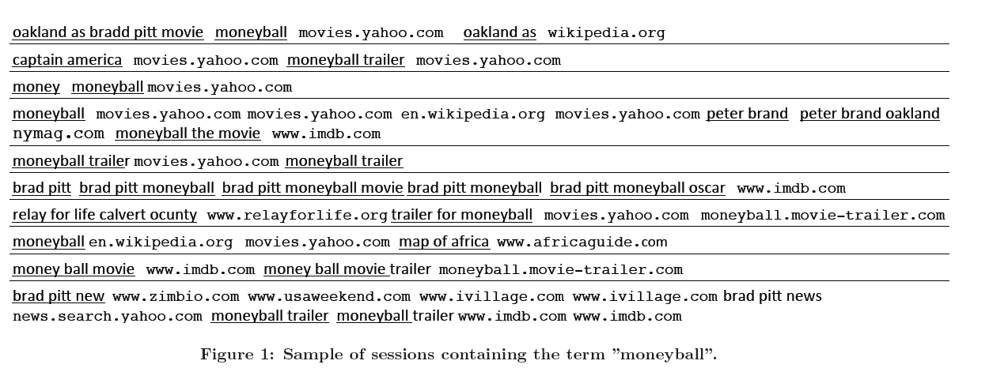
Introduction
We aggregate the information into sessions

Slide 5
Introduction
A key challenge is that query logs is the notable sparsity
because 64% percent of queries are unique within a year
So we have an idea that mining web log with semantic analysis

Slide 6
Outline
Introduction
Method and Evaluation
Conclusion

Slide 7
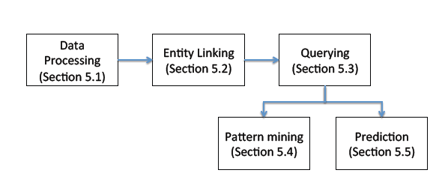
Workflow
Our proposed workflow for semantic usage mining
data collection and processing, entity linking, filtering, pattern mining and learning

Slide 8
Data Processing
Collected a sample of server logs of Yahoo! Search in the United States from June, 2011
Limit the collected data to sessions about movie and sessions contain at least one visit to any of 16 popular movie sites
Collected 1.7 million session, containing over 5.8 million queries and over 6.8 million clicks

Slide 9
Data Processing
Apply the filtering of navigational queries and we identify 117663 navigational queries, which makes it the 12th most frequent category of queries from all other semantic types
Definition 1 (Navigational Query).
Given a query q that leads to a click $C_{w}$ on webpage w, and given that q is linked to entity e, q is a “navigational query” if the webpage w is an offcial homepage of the entity e.

Slide 10
Entity Linking
Linking Queries to Entities
link the queries to entities of the semantic resources : Freebase
Choose the first result which is searched by adding “site:wikipedia.org” in Yahoo! Search to link queries to entities

Slide 11
Entity Linking
Linking Entities to Types
Use Freebase API to do it but it has some strange cases, e.g. for the entity “Arnold” the type bodybuilder is chosen as the most notable, rather than the more intuitive types politician or actor

Slide 12
Entity Linking
Linking Entities to Types
In order to improve this problem we have four rules:
disregard internal and administrative types, e.g. to denote which user is responsible
prefer schema information in established domains over user defined schemas
aggregate specific types into more general types
all specific types of location are a location
all specific types of award winners
always prefer the following list of movie related types over all other types: /film/film, /film/actor, /artist, /tv/tv_program, /tv/tv_actor

Slide 13
Entity Linking
Dictionary Tagging
Label queries with a dictionary created from the top hundred most frequent words and we can capture the intent of the user regarding the entity.
The top twenty terms that appear in our dictionary are as follows:
movie, movies, theater, cast, quotes, free, theaters ,watch , 2011, new, tv, show, dvd, online, sex, video, cinema, trailer, list, theatre . . .

Slide 14
Entity Linking
Evaluation
Provide a rater with the queries and ask user to manually create links to Freebase concepts
Compare manually created < query, entity> and < entity, type> pairs to automatically created links

Slide 15
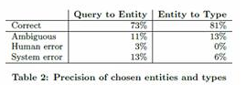
Entity Linking
Evaluation
50 most frequent queries and 50 random queries
50 most frequent entities and 50 random entities

Slide 16
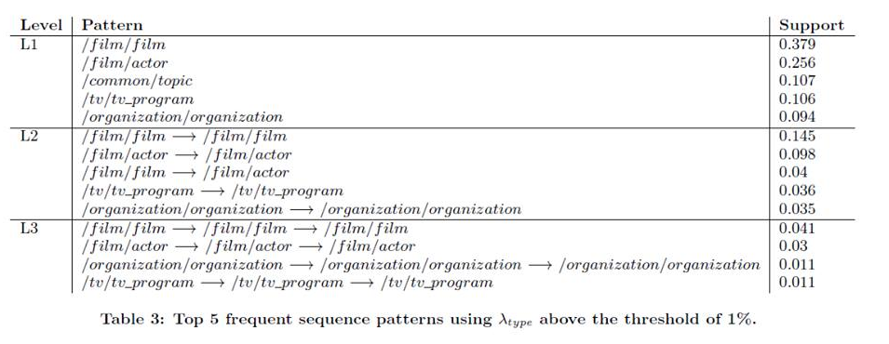
Semantic Pattern Mining
Multi-query patterns
Use the PrefixSpan algorithm and its implementation in the open source SPMF toolkit

Slide 17
Semantic Pattern Mining
Multi-query patterns
By looking at the actual entities and modifiers in queries, we find the user are looking for the same information about different entities
We can also filter our data using our indices to interesting subsets of sessions i.e. for new movies user are interested in the trailer while for old movies user are interested in cast

Slide 18
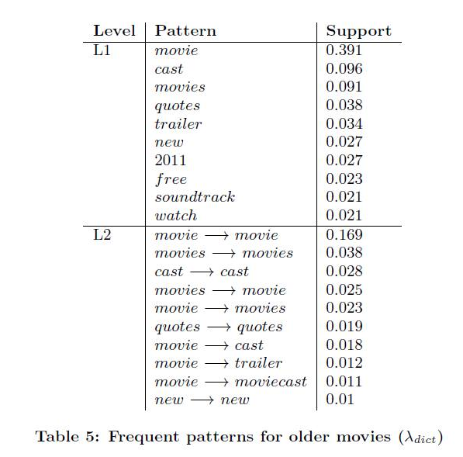
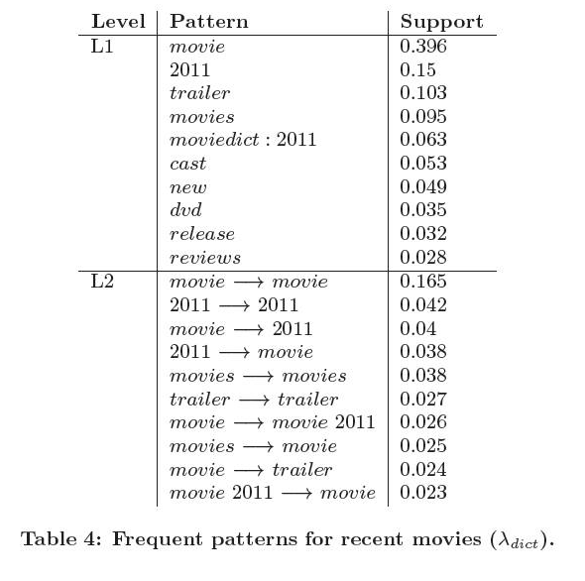
Semantic Pattern Mining
Multi-query patterns

Slide 19
Predicting Website Abandonment
When the user navigate away from the website, we can speak of users being lost
Definition 2 (Loosing query). Given a query q that leads to a click $C_{w}$ on website w, q is a “loosing query” if one of the following two session patterns occur:
1. q1 - cw - q2 - co
2. q1 - cw - co
where website o is different from website w, and q1 and q2 are
linked to the same entity.
predict abandonment by Gradient Boosted Decision Tree(GBDT)

Slide 20
Predicting Website Abandonment
Evaluation
We want to predict that a user will be gained or lost for a particular website
There are three tasks addressed using supervised learning:
Task 1 predict that a user will be gained or lost for a given website. We use all features, including the click on the loosing website
Task 2 predict that a user will be gained or lost for a given website, excluding the loosing website as a feature
Task 3 predict whether a user will be gained or lost between two given websites

Slide 21
Predicting Website Abandonment
Evaluation
We report results in terms of area under the curve(AUC)
Total amount of around 150K sessions
The training and testing is performed using 10-fold cross-validation

Slide 22
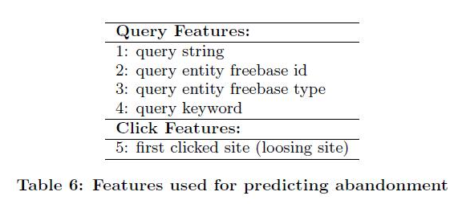
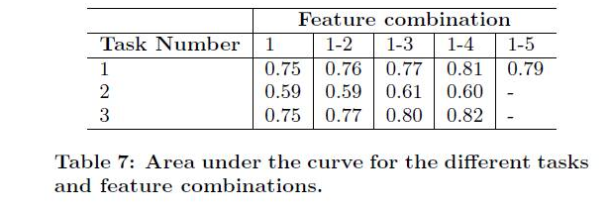
Predicting Website Abandonment
Evaluation

Slide 23
Outline
Introduction
Method and Evaluation
Conclusion

Slide 24
Conclusion
Our method depends on the availability of Linked Open Data on the topics of the queries
To analyze query patterns and predict website abandonment we first linked queries to entities and then generalized them to types
Further research is needed to verify whether other domain benefit from this type of analysis

